Slide 1
Employee Performance Analysis Using Excel
PRESENTED BY: YUVASHREE M
REGISTER NO.: 312204643
DEPARTMENT: COMMERCE
COLLEGE: K.C.S KASI NADAR COLLEGE OF ARTS AND SCIENCE

Slide 2
PROJECT TITLE
Employee Performance Analysis
Using Excel

Slide 3
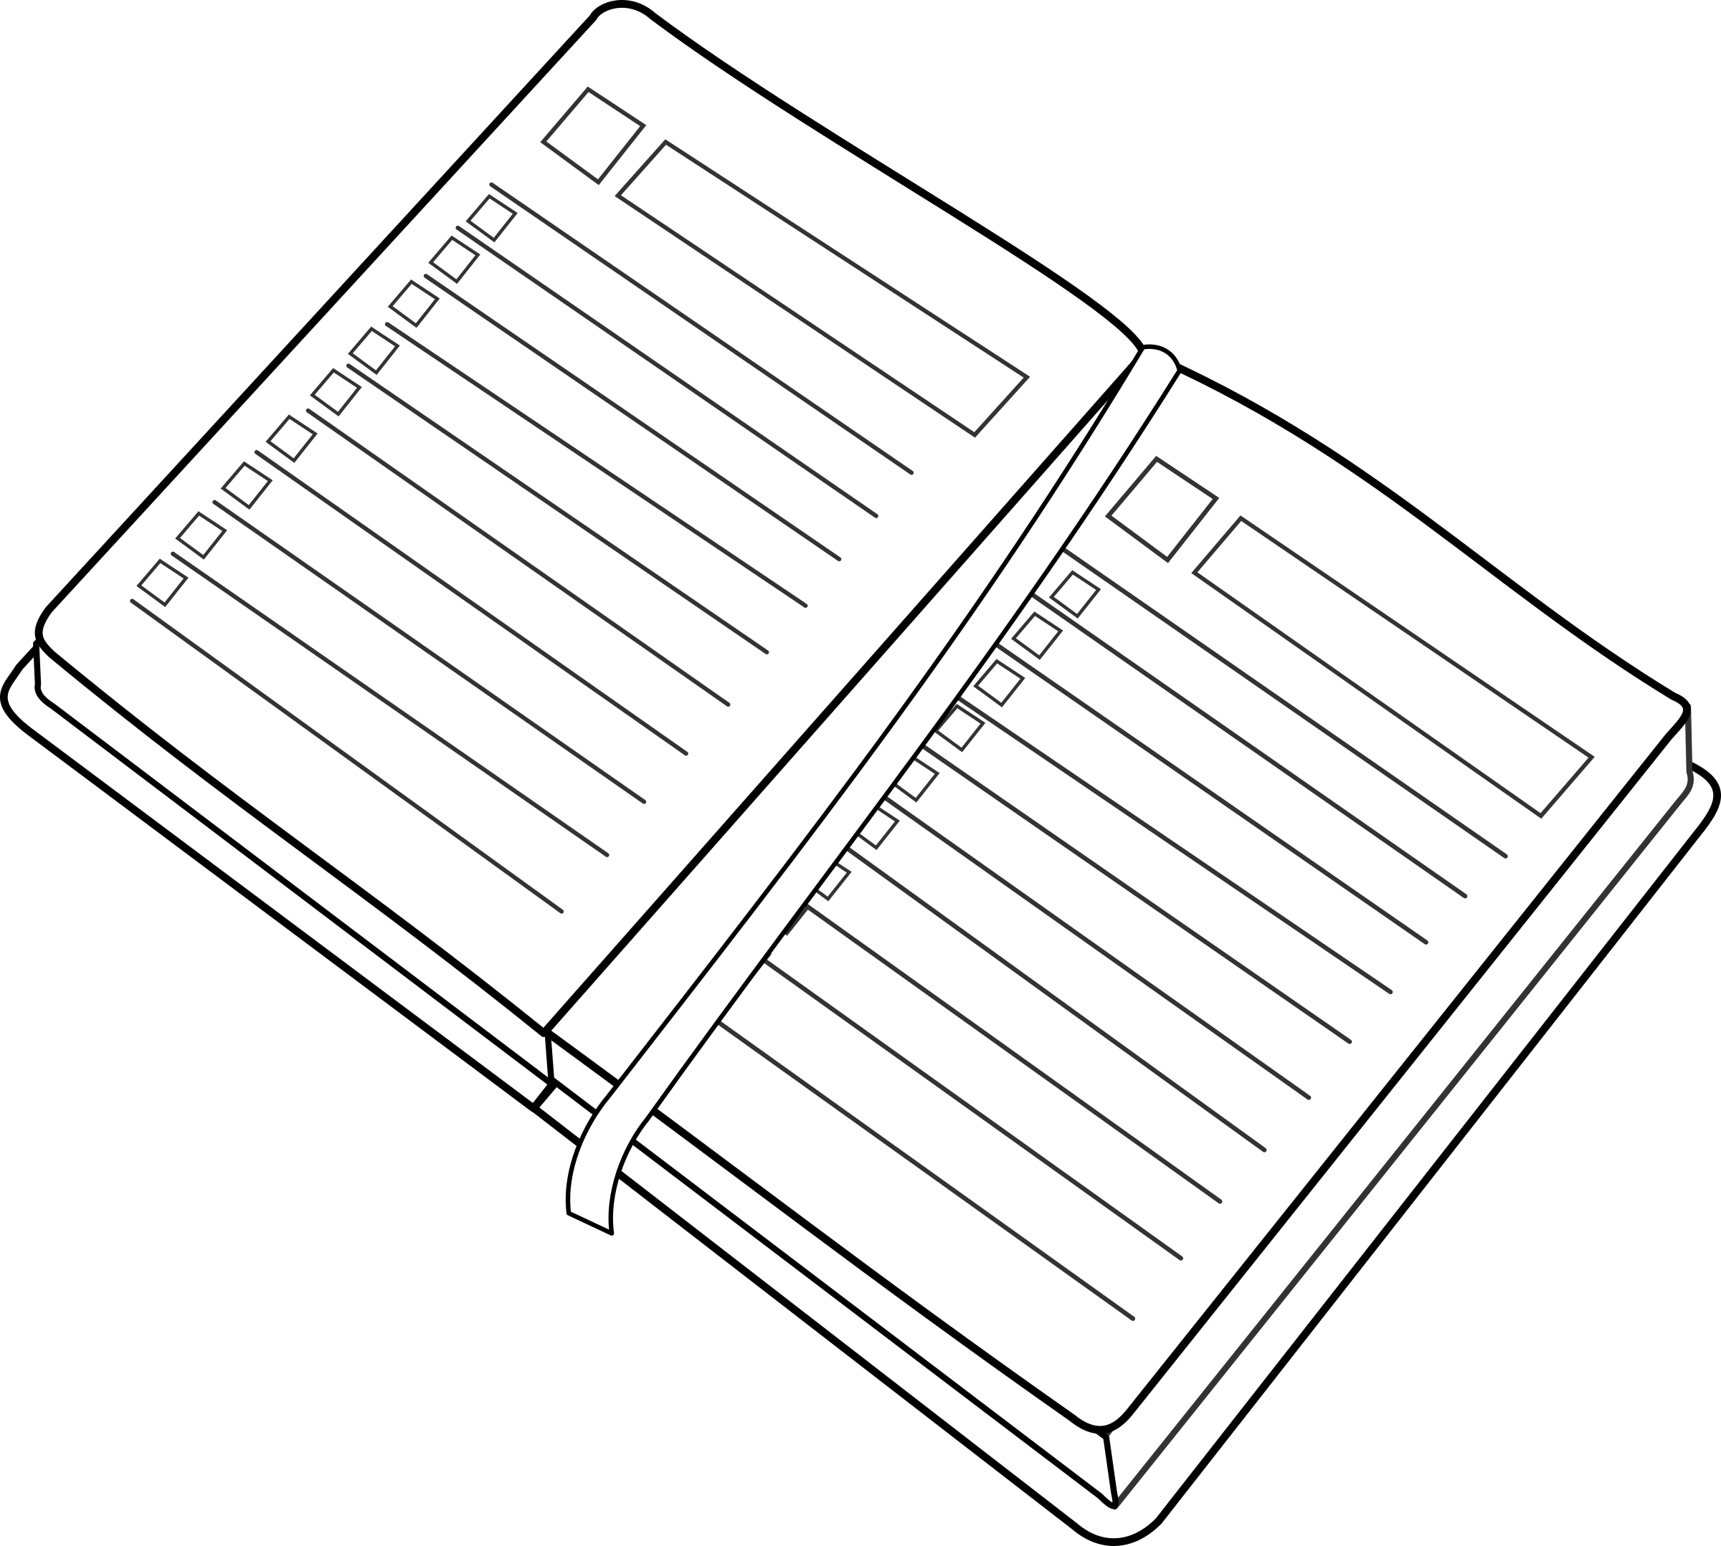
AGENDA
1.Problem Statement
2. Project Overview
3.End Users
4.Our Solution and Proposition
5. Dataset Description
6. Modelling Approach
7. Results and Discussion
8.Conclusion

Slide 4
PROBLEM STATEMENT
The company is looking to analyze employee performance ratings across different departments and job functions to identify patterns and areas for improvement. The current dataset includes employee IDs, names, department types, job functions, and their respective performance ratings.
Objective:
EVALUATE PERFORMANCE ACROSS JOB FUNCTIONS: Determine how performance ratings …vary by different job functions within the IT/IS and Executive Office departments. Identify …any job functions that consistently have lower or higher ratings.
DEPARTMENT-WISE COMPARISON: Compare the average employee ratings between the …IT/IS department and the Executive Office department. Assess if there are significant …differences in ratings across these departments.
OVERALL PERFORMANCE INSIGHTS: Provide an overall summary of employee performance …ratings and highlight any trends or patterns that could indicate areas for organizational …improvement or recognition.

Slide 5
PROJECT OVERVIEW
[ANALYZING EMPLOYEE PERFORMANCE RATINGS]
The primary goal of this project is to analyze and interpret employee performance ratings across different departments and job functions within the organization. This analysis aims to identify performance trends, evaluate departmental differences, and uncover insights that can drive organizational improvements and employee development initiatives.
SCOPE:
-Job Function Performance Analysis
-Departmental Comparison
-Trend and Pattern Identification
SUCCESS CRITERIA:
Accurate and insightful analysis of employee performance ratings.
Clear identification of performance trends and departmental differences.
Actionable recommendations based on data-driven insights.
Positive feedback from stakeholders and implementation of suggested improvements.
DELIVERABLES
-Pivot Charts and Tables
-Analysis Report
-Presentation

Slide 6
WHO ARE THE END USERS?
Human Resources (HR) Department
Department Managers (Sales & Production)
Senior Leadership/
Executives
Employees
Finance/Compensation Teams

Slide 7
OUR SOLUTION AND ITS VALUE PROPOSITION
FILTERING - Remove missing values.
CONDITIONAL FORMATTING - Blanks, Background Color Shading, Data Bars, Values.
DATA FILTERING AND SORTING - Identify specific employee groups, such as those with exceeds, needs improvement and fully meets.
PIVOT TABLE - Summary of employee performance under their current rating .
GRAPHS - FINAL REPORT.

Slide 8
DATASET DESCRIPTION
EMPLOYEE ID: Unique identifier for each employee in the organization.
FIRST NAME: The first name of the employee.
DEPARTMENT TYPE: The broader category or type of department the employee's work is associated with.
JOB FUNCTION: A brief description of the employee's primary job function or role.
CURRENT EMPLOYEE RATING: The current rating or evaluation of the employee's overall performance.

Slide 9
MODELLING
DATA SET: Kaggle, Employee dataset.
FEATURE SELECTION: Slicer, Conditional Formatting, Designing.
DATA CLEANING: Missing values, Irrelevant data, Correct Errors, Remove Unnecessary Columns and Rows.
PIVOT TABLE: Employee ID, First Name, Department Type, Job Function, Current Employee Rating.
CHART: Report of Employee Performance based on their Employee ID is resented in Values and Performance score presented
as Column Chart.

Slide 10

RESULTS

Slide 11

CONCLUSION
The analysis of employee performance ratings across different job functions and departments has yielded several key insights:
1.Consistent performance ratings across job functions
2.Departmental comparison
3.Lack of variation
4.Recommendations for improvement
In summary, while the data shows uniform performance ratings, this consistency also presents an opportunity for the organization to enhance its performance evaluation process. By addressing potential limitations in the rating system and focusing on targeted development initiatives, the organization can work towards better differentiating employee performance and fostering continuous improvement.
This Photo by Unknown Author is licensed under CC BY-SA

Slide 12
REFERENCE
Mrs Nirmala P
Assistant Professor,
K.C.S Kasi Nadar College of Arts and Science
Chennai, Tamil Nadu.
Ms Shakthi Balambigai V
Assistant Professor,
K.C.S Kasi Nadar College of Arts and Science
Chennai, Tamil Nadu.

